Slide 1
MyCollege App
Created By
Atharva Pradhan

Slide 2
Over View
Websites do not support Mobile devices.
Lack Resolution support or Design.
80% population dependent on mobiles.

Slide 3
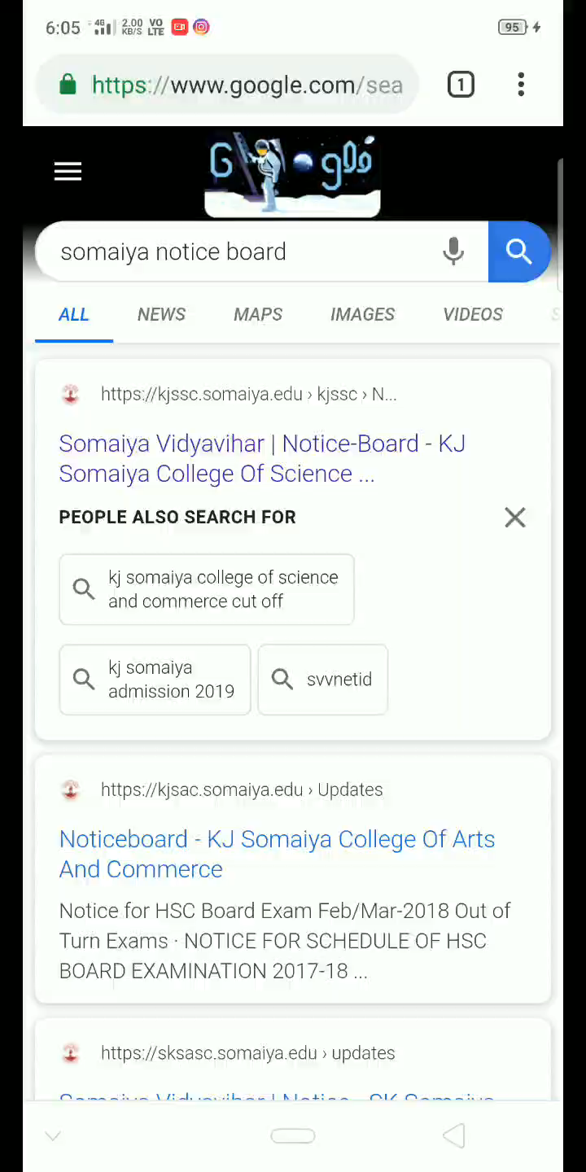
Problem
Resolution and Design support missing for mobiles.
Difficult in navigation.

Slide 4
Objective
User-friendly interface to view notices.
Function in simple and initiative manner.

Slide 5
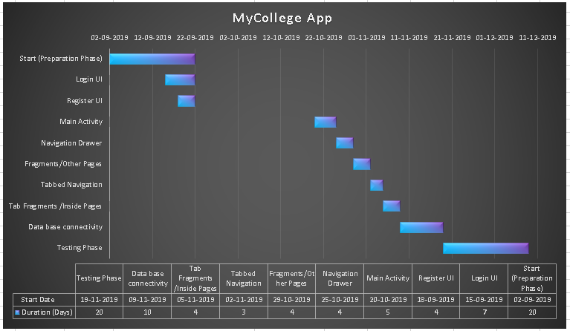
Gant Chart

Slide 6

Functionality
Simple UI
Filtration of information as per criteria.
One Click hassle free experience.

Slide 7
Thank You

